Slide 1
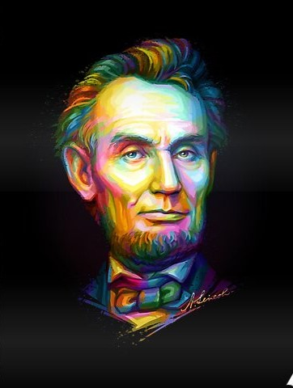
What is Democracy? Why Democracy?
Social Studies Presentation

Slide 2
Important Topics
1
2
3
4
5
What Is Democracy
Features Of Democracy
Major Decisions Taken By Elected Leaders
Free And Fair Electoral Competition
One Vote, One Person, One Value

Slide 3
Important Topics
6
7
8
9
10
Rule of Law and respect for rights
Why Democracy ?
Arguments for democracy
Broader Meanings of Democracy
Summary

Slide 4
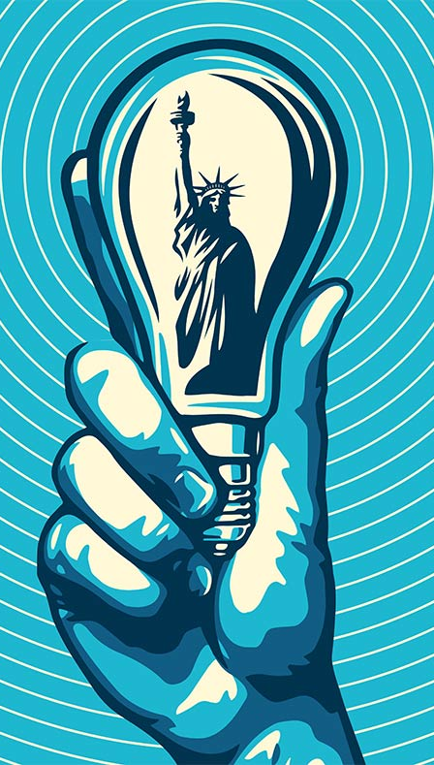
Introduction
In This Chapter We Will Study/Understand About The Basics Of Democracy , Why Democracy Is Important For Us, What Are The Feature Of Democracy, History Of Misuse Of Democracy By The Leaders Of Pakistan , Broder Meaning Of Democracy, One person, One vote, One value, Rule of Law and respect for rights

Slide 5
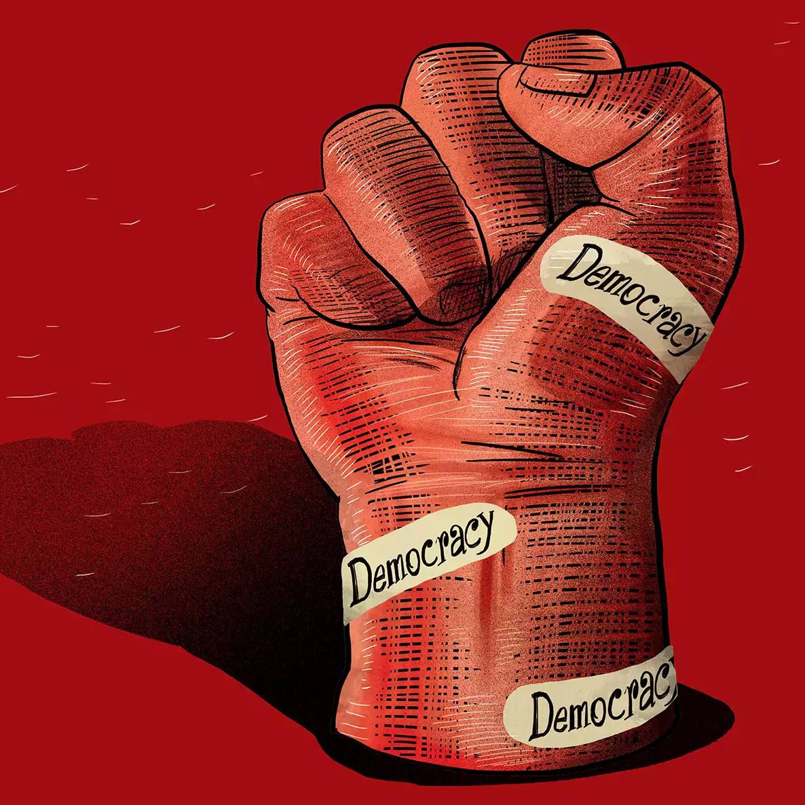
What Is Democracy
Cleisthenes Is Considered As The Father Of Democracy

Slide 6
Democracy Is A Form Of Government In Which People Select Their Own Representative In The Form Of Leaders By The Process Of Voting Basically Democracy Is Made Up Of Two Greek Words “Demos” Meaning People And “Kratia” Meaning Rule Which In Total Means People’s Rule
“
”

Slide 7
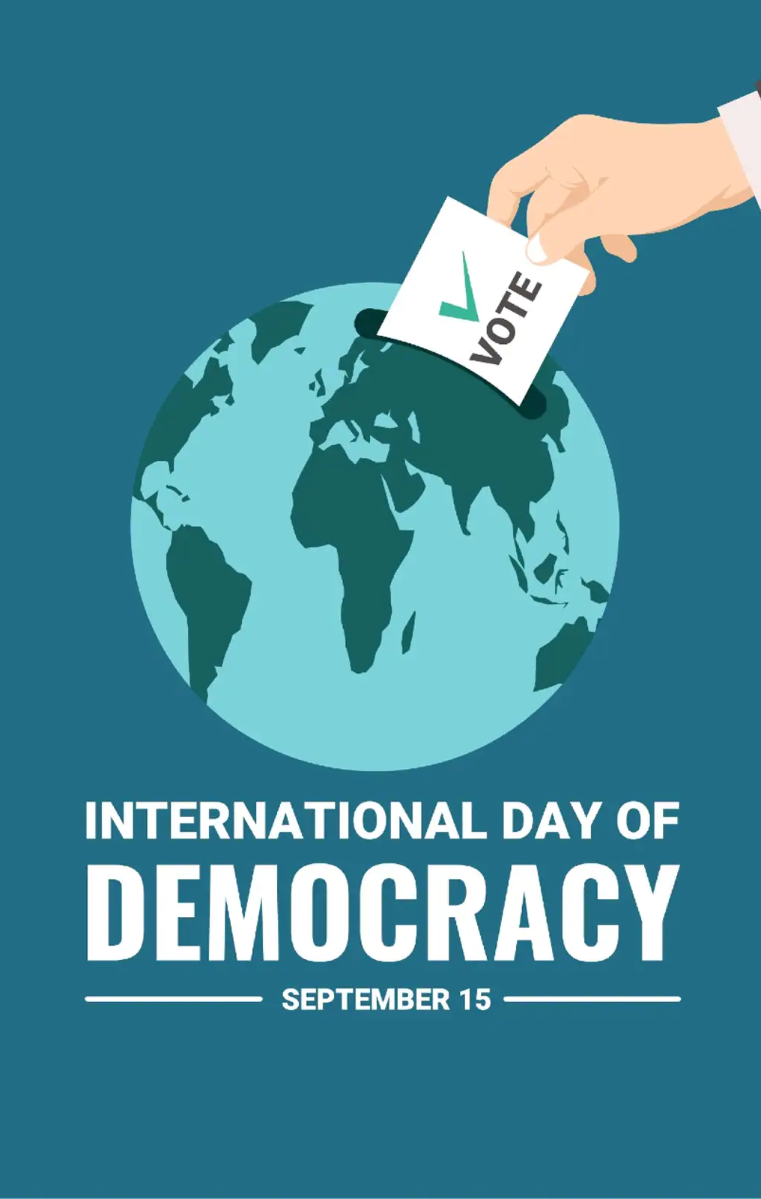
Features of Democracy
Democracy is a form of government in which the rulers are elected by the people
Its Main Key Features Are :-
1) Respect for basic human rights, 2) A multi-party political system paired with political tolerance, 3) A democratic voting system, 4) Respect for the rule of law, 5) Democratic governance, and 6) Citizen participation

Slide 8
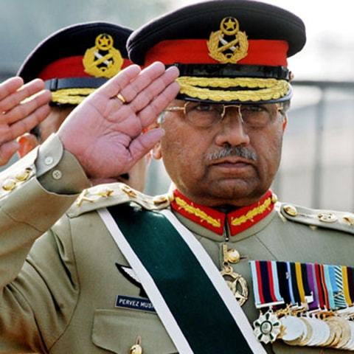
Pervez Musharraf
Former President Of Pakistan
Let’s See What Parvez Musharraf Did After Coming Into Power

Slide 9
✔General Pervez Musharraf was the former President of Pakistan. He was the most popular leader in the country, Pakistan for being the most disliked. ✔He was the President of Pakistan from 2001 and till his impeachment in 2008. He earlier led a military coup in 1999 and became the President of Pakistan by overthrowing the democratically elected government. ✔Later he held a referendum which granted him a 5-year extension. Then he passed the Legal Framework Order for attaining all the powers to dismiss the national and provincial assemblies. -Source:Brainly
Social Studies

Slide 10
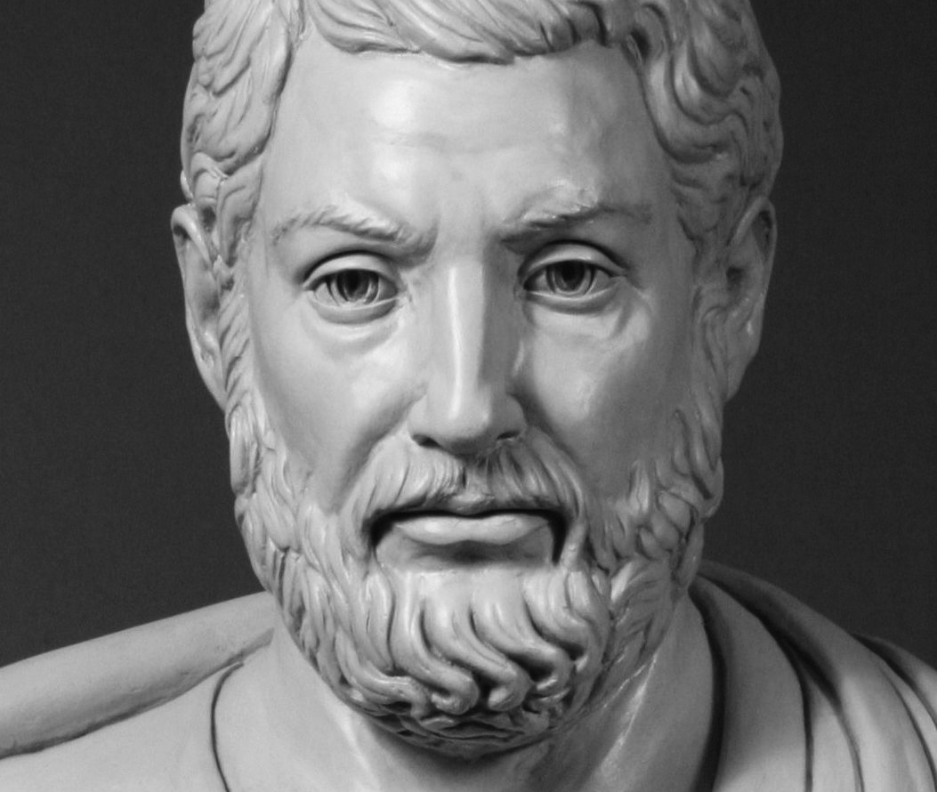
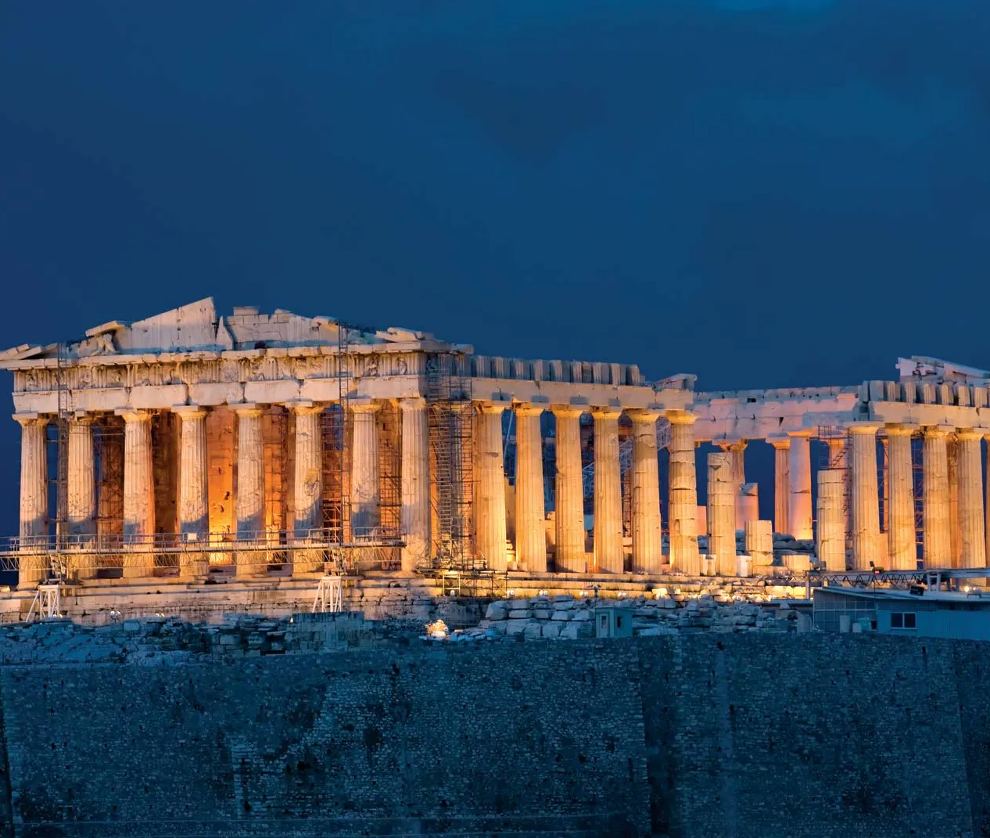
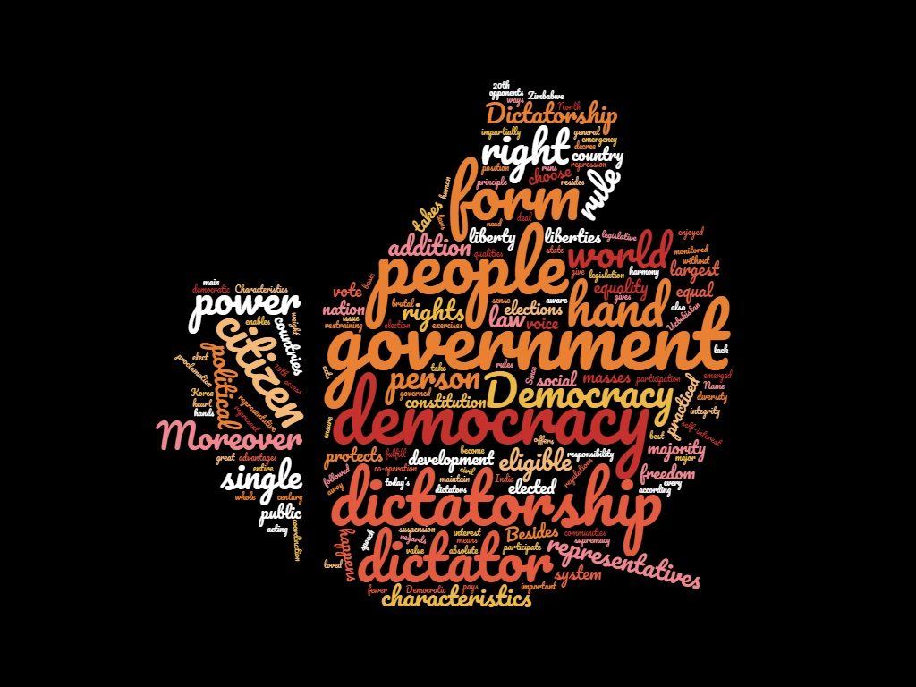
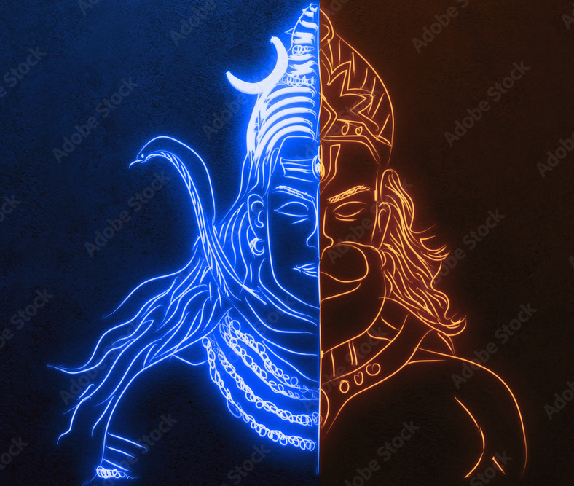
Fact Time
Cleisthenes
Athens, Greece
Republic Of India
Four Types Of Democracy
Founder of Democracy
The Place Where Democracy Was First Practiced
August 15, 1947
Direct democracy.
Representative democracy.
Constitutional democracy.
Monitory democracy.

Slide 11
Free and fair electoral competitione Elections is the basis of democracy, so conducting free and fair electoral competition is important. Free and fair electoral competition means elections take place without violating any rules and regulations, the political parties abide by the electoral guidelines and do not misuse their powers. 1. Without competition, the election would become meaningless. If there are no competitors, then there would be assurance of winning the election by the single party. The competition in election holds the contestants accountable. 2. The competition in the election also increases the voter’s knowledge of the representation. 3. The competition keeps the political leaders motivated to work for the upliftment of the society and country

Slide 12
One person, one vote, One value This Slogan “One person one vote One value” signifies that every person irrespective of its color creed gender caste shall be considered Equal when He/She fulfils their duty to select a Representative by the process of voting and every vote’s value should be equal in selecting the representative

Slide 13
Importance of One person, one vote, One value It stresses on, political equality. It means that everyone in the country irrespective of the caste, colour, gender, creed and income earned is allowed to vote for his own representative, i.e., the choice and opportunity is available to all the citizens on an equal basis without any discrimination on the basis of gender, caste, colour,etc. The policy of one persons one vote, and one value should be followed in a democracy.

Slide 14
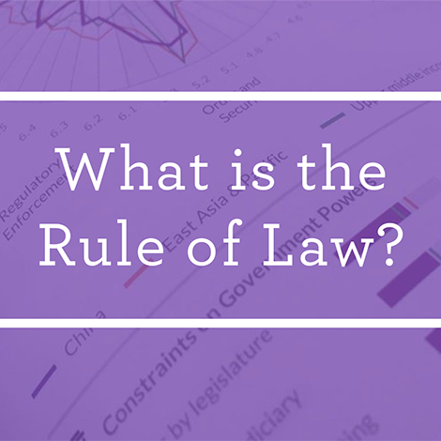
Rule of Law and respect for rights
Social Studies Presentation

Slide 15
Rule of Law and respect for rights Rule of law means every individual in a democracy should abide by the law, or a constitution which is made. It also includes that no person would violate the laws. Thus, rule of law governs a state in democracy. Respect for rights mean that every citizen of a democratic state is provided with some important rights and it is a duty of everybody to respect each other’s rights and comply with them.

Slide 16
Why Democracy ? The word democracy refers to rule by and for the people. We need democracy for: * Democracy helps in maintaining law and order with concept of power sharing. * Democracy helps citizens to choose their leaders to run the government by free and fair elections. * Democracy provides equal rights among citizens on the basis of caste, religion and sex. * Democracy enhances the quality of decision-making and also improves the dignity of citizens. * Democracy provides a system to deal with differences and disagreements and also allows us to correct our own mistakes.

Slide 17
China For the following reasons China is not regarded as a democratic country: 1. China is ruled by a single party known as the Communist Party. 2. Though elections are held there, only the members of the Communist party or its allied parties can contest polls. In this way, only the Chinese Communist party forms the government in China. 3. China does not hold fair and free elections. Therefore, China cannot be regarded as a Democracy.

Slide 18
Mexico Mexico is not a democratic country because in Mexico from 1930 till 2000 every election was won by P.R.I (Institutional Revolutionary Party). The PRI was known to use many dirty tricks and unfair practices to win elections. The teachers, governments, and employees forced the citizens to vote for PRI.

Slide 19
True Defination Of Democracy In a democratic country, every voter has equal right's and every vote carries equal value. The elections are said to be fair when a voter gets to vote according to his/her wish and willingness to vote.Not only this, but the elections must be conducted on regular intervals, as stated in the constitution.There must not be any use of muscle power for diverting votes, neither should voters be bribed for voting a particular representative.

Slide 20
Broader Meanings of Democracy In This Chapter We Understood , Democracy Is A Kind Of Government In Which People Select Their Representatives In The Form Of Leaders This Gives People Several Rights And Helps In Development Of The Country A majority is allowed to take decisions on behalf of all the people. Even the majority does not rule directly. The majority of people rule through their elected representatives

Slide 21
Summary Let us sum up the discussion so far. We started with a simple definition that democracy is a form of government in which the rulers are elected by the people. We found that this definition was not adequate unless we explained some of the key words used in it. Through a series of examples we worked out four features of democracy as a form of government. Accordingly, democracy is a form of government in which:

Slide 22
Rulers elected by the people take all the major decisions; (-) Elections offer a choice and fair opportunity to the people to change the current rulers (-) This choice and opportunity is available to all the people on an equal basis (-) The exercise of this choice leads to a government limited by basic rules of the constitution and citizens’ rights.

Slide 23
Thank You
By- Aarush Thakur
Class- 9th Alpha 1
Subject- Social Studies
Submitted To- Mr. Anshuman Tanwar

